Slide 1


Introduction to Logistic Regression
Wake Forest
School of Business
_______
BAN 7040

Slide 2
Logistic Regression
Primarily used for predicting binary responses
Non-linear transformation of a linear regression model based on the log-odds
Ultimate output is the probability that an observation falls into one of the two categories
Probability is used to classify each observation into its most likely category
Model-building process will mimic the process for building linear regression models

Slide 3
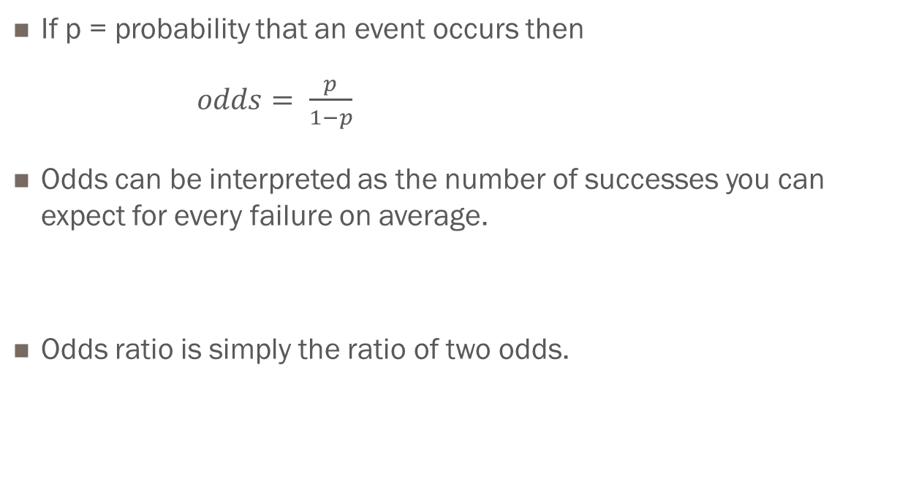
Odds and Odds Ratios
If p = probability that an event occurs then
$odds= \frac{p}{1−p}$
Odds can be interpreted as the number of successes you can expect for every failure on average.
Odds ratio is simply the ratio of two odds.

Slide 4
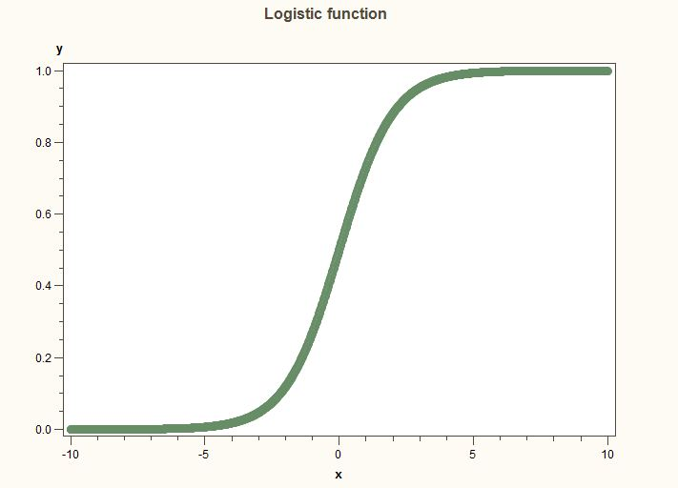
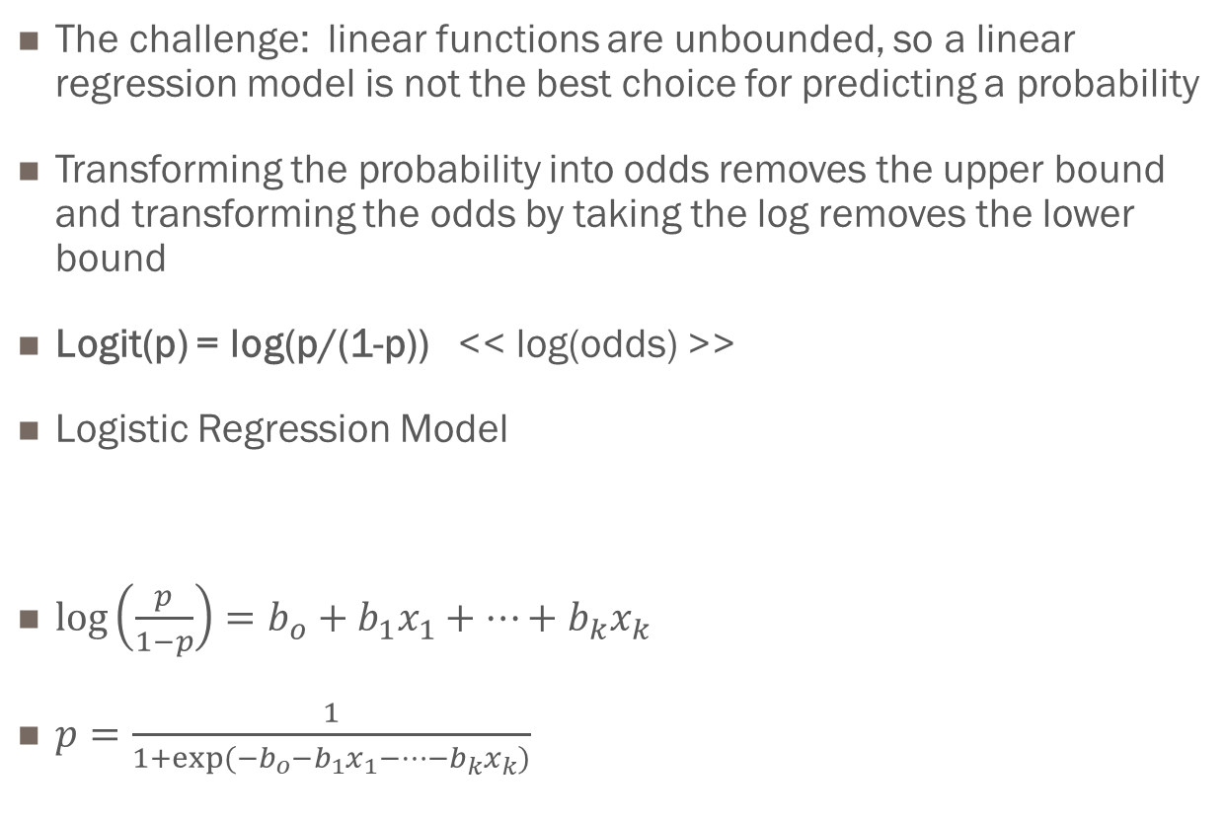
The LOGIT transformation
The challenge: linear functions are unbounded, so a linear regression model is not the best choice for predicting a probability
Transforming the probability into odds removes the upper bound and transforming the odds by taking the log removes the lower bound
Logit(p) = log(p/(1-p)) << log(odds) >>
Logistic Regression Model
$\log\left(\frac{p}{1−p}\right)=b_{o}+b_{1}x_{1}+…+b_{k}x_{k}$
$p=\frac{1}{1+{exp⁡(−b}_{o}−b_{1}x_{1}−…−b_{k}x_{k})}$

